Slide 1



Intro to Coding Bootcamp
For Everyone
Instructor-Led
Onsite or Remote
~7 Hours
Overview: HTML, CSS, and JavaScript combine to form the websites and applications we know and love. In this one-day workshop, you’ll learn the basics of creating interactive websites, along with the programmer's mindset that keeps web developers going in the face of constant challenges.
Learner Objectives:
Describe the roles of HTML, CSS, and JavaScript in web development.
Create a well-structured HTML document using elements and attributes.
Use CSS to apply styles to an HTML document.
Understand fundamental JavaScript syntax.
Use JavaScript to respond to user interactions on a webpage.

Slide 2
Program Schedule
Day 1
10–11:30 a.m. | Building the Web With HTML
11:30 a.m.–1 p.m. | Styling With CSS
1–2 p.m. | Lunch
2–3:30 p.m. | JavaScript Syntax
3:30–4:45 p.m. | JavaScript in Action
4:45–5 p.m. | Bring It Home

Slide 3
CodePens for This Workshop
This workshop uses CodePen to provide example and starter code. Students should fork copies of exercise CodePens to work from.
You can view a collection of all CodePens here: https://codepen.io/collection/XgyWyj.
Links are also provided on the activity slides throughout the workshop.

Slide 4
Intro to Coding Bootcamp
General Assembly

Slide 5
Agenda
Today’s Schedule
10–11:30 a.m. | Building the Web With HTML
11:30 a.m.–1 p.m. | Styling With CSS
1–2 p.m. | Lunch
2–3:30 p.m. | JavaScript Syntax
3:30–4:45 p.m. | JavaScript in Action
4:45–5 p.m. | Bring It Home
Notes:
PURPOSE: Share the day’s agenda with the class.

Slide 6
What is General Assembly?

Slide 7
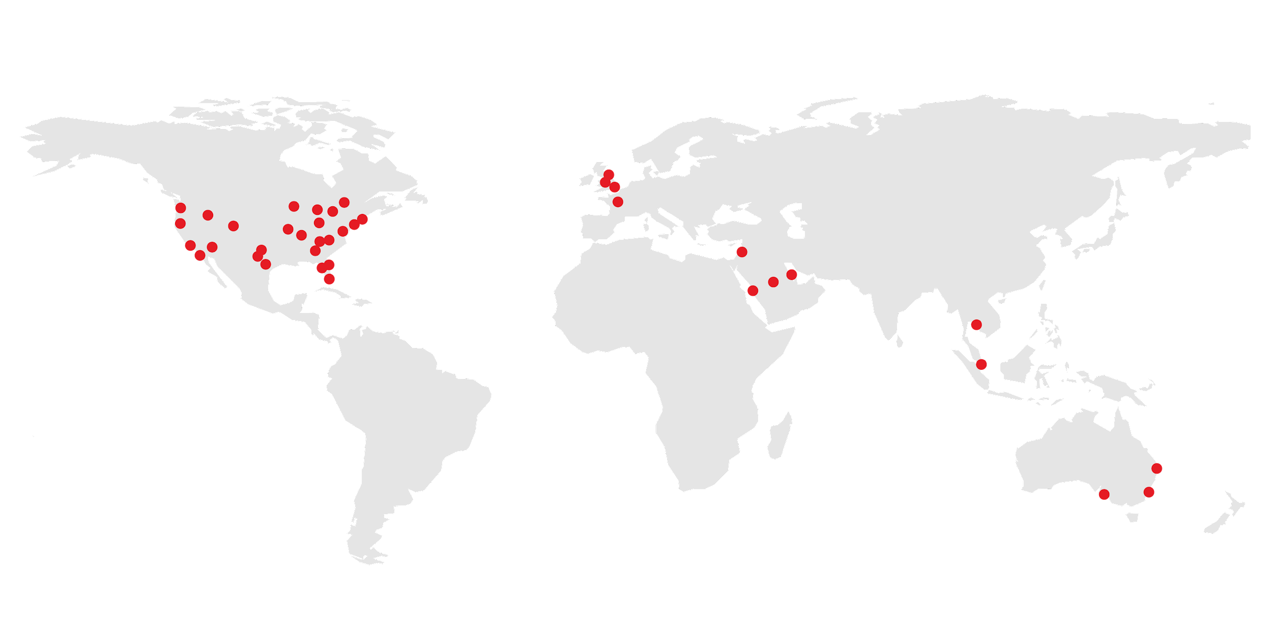
General Assembly is a pioneer in education and career transformation, specializing in today's most in-demand skills. We foster a flourishing community of professionals pursuing careers they love.
Notes:
PURPOSE: Introduce General Assembly.
TALKING POINTS:
So, who are we and why are you here? General Assembly, or “GA,” is a global education institution that specializes in the most in-demand skills across data, design, technology, and business.
We offer classes, workshops, and courses in web development, design, digital marketing, data science, and business with a range of commitment options.
As part of helping individuals like yourselves acquire new skills and/or transition into a new career, we also work with a global network of employers as a source of talent. More than 9,000 of our Immersive graduates have been hired into tech careers!

Slide 8




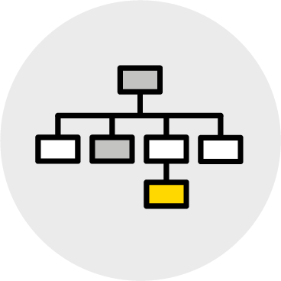

What We Teach
Coding
UX & Design
Data
Marketing
Business
Career Development
Notes:
PURPOSE: Share the subjects General Assembly teaches.

Slide 9

Meet Your Instructors <Bio Slide Optional>
Customize It!
{Your Name}
Title, Current Positions
{Bio Info}
{Insert Picture}
Notes:
PURPOSE: Introduce yourself.

Slide 10

Meet Your Classmates
5 Minutes
Customize It!
There’s a lot of work ahead, and you’re going to need fuel.
Please share:
Your name.
Why you’re taking this course.
Your favorite comfort food.
Notes:
PURPOSE: Spend a few minutes “breaking the ice” and getting people comfortable.
TEACHING TIPS:
If you have a large class (20+), don’t let everyone introduce themselves. Instead, have them post their answers on Slack, then call out a few highlights.
Customize It! Change the fun fact (No. 3) if you want, but avoid sensitive topics.
FOR REMOTE CLASSROOMS:
Have students come off mute to share their answers.

Slide 11
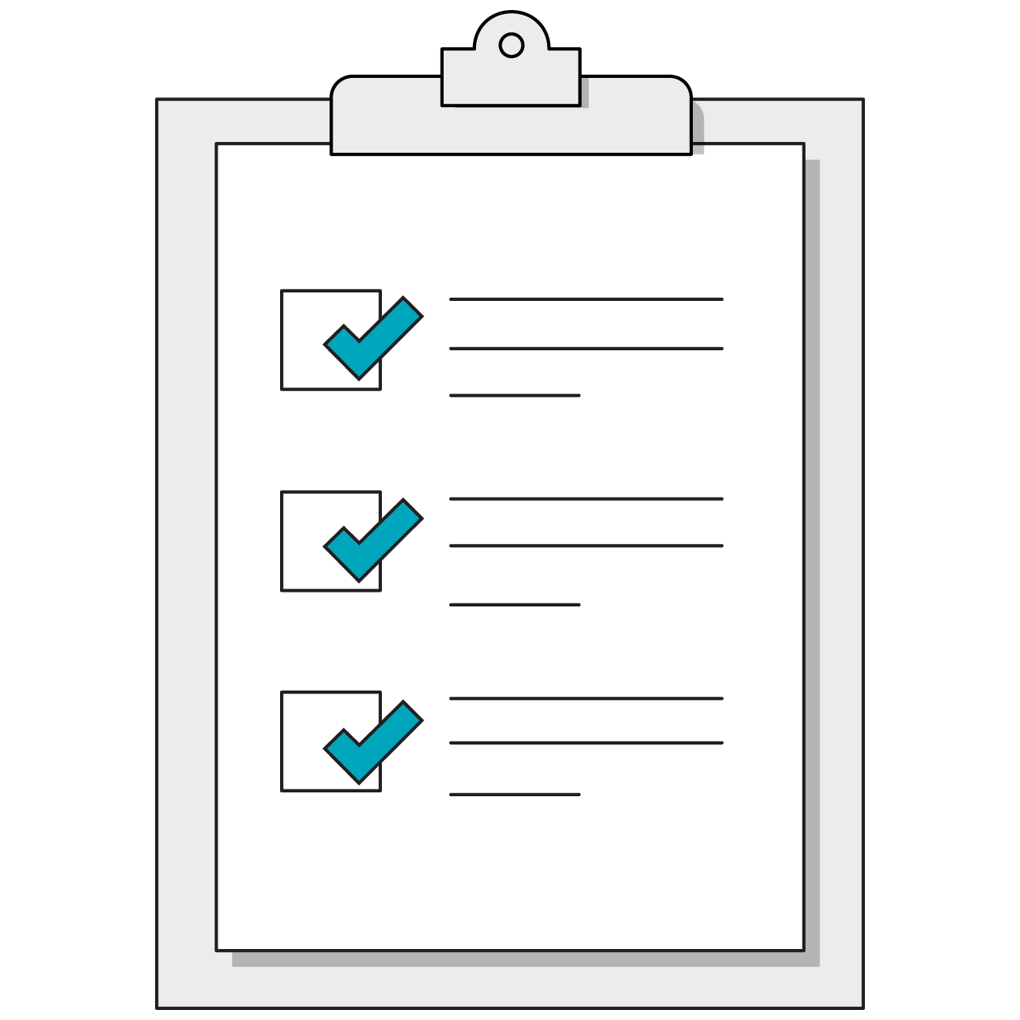
Our Goals for Today
Describe the roles of HTML, CSS, and JavaScript in web development.
Create a well-structured HTML document using elements and attributes.
Use CSS to apply styles to an HTML document.
Understand fundamental JavaScript syntax.
Use JavaScript to respond to user interactions on a webpage.
‹#› | © 2020 General Assembly
Notes:
PURPOSE: Introduce the learning objectives for the workshop.

Slide 12
Building the Web With HTML
Intro to Coding Bootcamp
Building the Web With HTML
Styling With CSS
JavaScript Syntax
JavaScript in Action
Notes:
DURATION: 90 Minutes

Slide 13
What’s Coming
Describe the roles of HTML, CSS, and JavaScript in web development.
Create a well-structured HTML document using elements and attributes.
‹#› | © 2020 General Assembly
Notes:
PURPOSE: Highlight the learning objectives for this section.

Slide 14
What is front-end development?
Content
HTML
Style
CSS
Bones
Skin
Interactivity
JavaScript
Brain
Notes:
PURPOSE: Introduce front-end development.
TALKING POINTS:
HTML provides directions to the web browser about what should be displayed on the webpage (i.e., its content).
CSS is the style added to that content.
JavaScript creates interactive elements.
Today, we’ll be practicing with HTML and CSS.

Slide 15
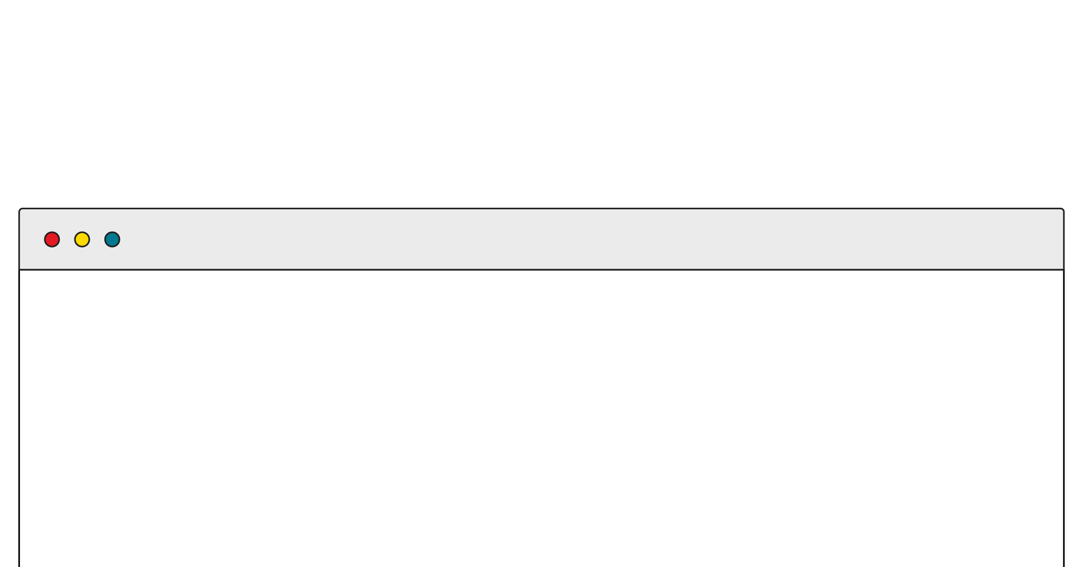
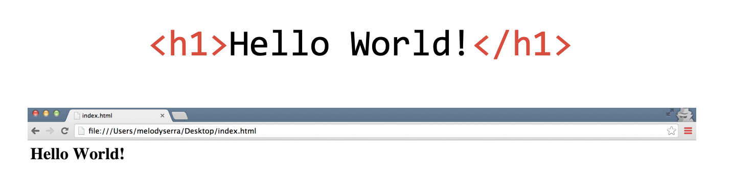
HTML: Hypertext Markup Language
HTML is made up of tags.
Tags tell the browser how to encode content (e.g., Will the content be formatted as an image or a link?).
< >
These symbols surround every tag.
Notes:
PURPOSE: Describe HTML tags.
TALKING POINTS:
Tags "mark" content as a specific type, such as a paragraph of text or an image.

Slide 16
HTML Basics
<!DOCTYPE html>
<html>
<head>
<title>GA</title>
</head>
<body>
<p>Hey GA!</p>
</body>
</html>
The <html> tag ALWAYS encloses the entire document.
The document type declaration for all HTML documents is the same:
<!DOCTYPE html>.. It’s ALWAYS the first item on a page.
Page content goes within <head> and <body> tags. The <head> contains what machines see, while the <body> contains what people see.
Notes:
PURPOSE: Introduce a basic HTML file.
TEACHING TIPS:
This slide shows a boilerplate HTML file. If you type this out in your code editor, you can demonstrate autocompleting tags to students so they don’t have to type out the brackets. This shows them that text editors can be powerful tools for productivity, and will get them more interested in shortcuts.

Slide 17
The Anatomy of HTML
Regular Tags
Self-Closing Tags (aka Void Tags)
<p>Hello GA</p>
Opening
Tag
Content
Closing
Tag
<img src="picture.jpg" />
<img src="picture.jpg" alt="A picture">
Tag
Attribute
Notes:
PURPOSE: Differentiate between regular tags and self-closing tags.
TALKING POINTS:
Most elements require content to be placed between opening and closing tags, although some can be “self-closing,” with no corresponding closing tag. This is typical for elements that link out to external content, such as images. You’re not putting anything inside image tags because the image is the content.

Slide 18
Attributes
Attributes are additional information we add to an element.
They appear in the opening tag of the element.
They are made up of two parts: a name and a value, separated by “=”.
<a href= “http://www.amazon.com”>Amazon</a>
Name
Value
href Attribute
Notes:
PURPOSE: Introduce attributes.
TALKING POINTS:
Attributes are additional information we add to an element. They appear in the opening tag of the element and are made of up two parts: a name and a value, separated by an “=” sign.
The attribute name indicates what kind of extra information you’re supplying about the element’s content.
The value is the information regarding the attribute.
A majority of attributes are unique to certain elements. One of these is the anchor element. Here, the href attribute gives us more information about the anchor — it tells the browser where to go when the user clicks on the text.
Additional resource: https://html-css-js.com/html/tutorial/html-tag-attributes.php

Slide 19
Hello, inspector!
10 Minutes
Visit one of your favorite websites and identify three HTML tags used within it. See if you can guess what that tag might mean.
To view the HTML structure of a page using Google Chrome, simply right click on any element on the page and choose “Inspect.” This will open the DevTools panel (this is your new world!) and allow you to view and edit the HTML structure underlying the page.
Then, you might use resources such as W3Schools to get a sense of what the tag means and its most common use cases.
‹#› | © 2020 General Assembly
Notes:
PURPOSE: Start using the DevTools panel and encourage students to do so throughout all activities.
TEACHING TIPS:
You can solicit answers from students and keep track of the tags they’ve identified. If you keep a tally of how often a tag is mentioned, you can create a picture of the most frequently seen or used tags, which should flow well into the next few slides that define the most common ones.
You can also mention that divs, sections, etc. are containers for other tags and define the structure of the site (the DOM tree/parents/children).
You should demonstrate the DevTools panel yourself and show how you can alter anything about a website by editing, adding, or deleting elements. Note that this doesn’t actually save changes to the original page.
Hover over elements in the Inspector to demonstrate its capabilities.

Slide 20
Common Body Tags
Element | Description | Example
h1 | Main headings. | <h1>The Explorer</h1>
h2–h6 | Subheadings. | <h2>Articles</h2>
p | Paragraph of text. | <p>This is a really cool site.</p>
a | Anchor tag for links to other web addresses. | <a href=”google.com”> Search for stuff </a>
img | Images. | <img src=”pic.jpg”>
Notes:
PURPOSE: Describe common body tags in HTML.
TALKING POINTS:
Without HTML, all text renders at the same level. We want to create hierarchy and structure to our site, so we start with indicating which text is a header, a subheader (of multiple levels), or just plain old paragraph text.
Anchor and image tags can create connections between our webpage and other sites or image files.
TEACHING TIPS:
Walk students through the elements above.

Slide 21
Common HTML Tags: Lists
Element | Description | Example
li | List Item | <ul> <li>Monday</li> <li>Tuesday</li> <li>Wednesday</li> </ul>
ul | Unordered List
ol | Ordered List | <ol> <li>Monday</li> <li>Tuesday</li> <li>Wednesday</li> </ol>
Notes:
PURPOSE: Define list tags in HTML.
TALKING POINTS:
Let’s talk about adding another element to your page: lists.
Lists are either unordered (with plain bullets) or ordered (with numbers). Ordered or unordered list tags will tell your browser to display the list item with a bullet or a number.

Slide 22
Tags in the Document Head
Element | Description | Example
link | Links a CSS style sheet. | <link href=”css/style.css”>
title | Website title that shows up in the browser tab. | <title>My website</title>
Notes:
PURPOSE: Define document head tags in HTML.
TALKING POINTS:
Let’s talk about the elements found only in the <head> tag, such as <link> and <title>.
The value assigned to <title> will be visible in the browser’s tab for that page.
<link> is used to import a CSS file. A page can import multiple CSS files and would therefore require a <link> tag to reference each one.

Slide 23

Visualize Your HTML Tags as a Tree
Notes:
PURPOSE: Provide students with a visualization tip for HTML tags.
TALKING POINTS:
Tags help define hierarchy for a website. Each element is related and connected to other elements nearby, including parent and children elements.
TEACHING TIPS:
You can go back to the website you inspected and point out some of these relationships. What you want to show is the nesting of tags, with parent tags like <body> and <main> acting as the trunk of a tree, and the <a>, <img>, and <p> tags acting as leaves. Draw it on the board to create a visual representation.

Slide 24
Elements Can Have Parents, Children, & Siblings
<body>
<h1>
<ul>
<li>
<li>
<li>
Notes:
PURPOSE: Demonstrate the familial relationships between HTML elements.
TALKING POINTS:
Notice how the <body> element is a parent one level up from the <h1> and <ul> elements?
However, the <ul> element is both a child of the <body> element and a parent of the <li> elements. This is common with HTML.
TEACHING TIPS:
Point out the sibling, children, and parent relationships in the diagram.

Slide 25
Tools of the Trade: CodePen
While you'll probably want code editor software such as VS Code and Atom to continue your learning, the easiest way to get started on front-end coding is with an online code editor like CodePen.
CodePen gives you space to work with HTML, CSS, and JavaScript and connects them behind the scenes for you. We'll work with CodePen for examples and challenges today, then you can use the code editor of your choice once you feel comfortable enough with the concepts.
Notes:
PURPOSE: Introduce CodePen.
TEACHING TIPS:
Encourage students to create a free account to save their progress and fork example code. This should be easy, especially if they use a linked Google account.
Direct students to open up CodePen and have a new Pen started for all activities, including those on the next slide.

Slide 26
Let’s Recreate This Slide in HTML
10 Minutes
Hypertext Markup Challenge
Using the following HTML tags, recreate the contents of this slide, not including the teal title portion. Tags you should use include:
<h1>
<p>
<ul>
<li>
Notes:
PURPOSE: Give students the opportunity to practice creating HTML files.
TEACHING TIPS:
Because this will be your students’ first partner or group activity, suggest a specific tech setup for working together. Ideally, a pair programming driver-navigator pattern should emerge, instead of two students working silently in parallel.
FOR REMOTE CLASSROOMS:
This will be the first breakout room experience, so give students some extra time to acclimate. Pop into as many rooms as possible to demonstrate that you can visit them as needed.

Slide 27

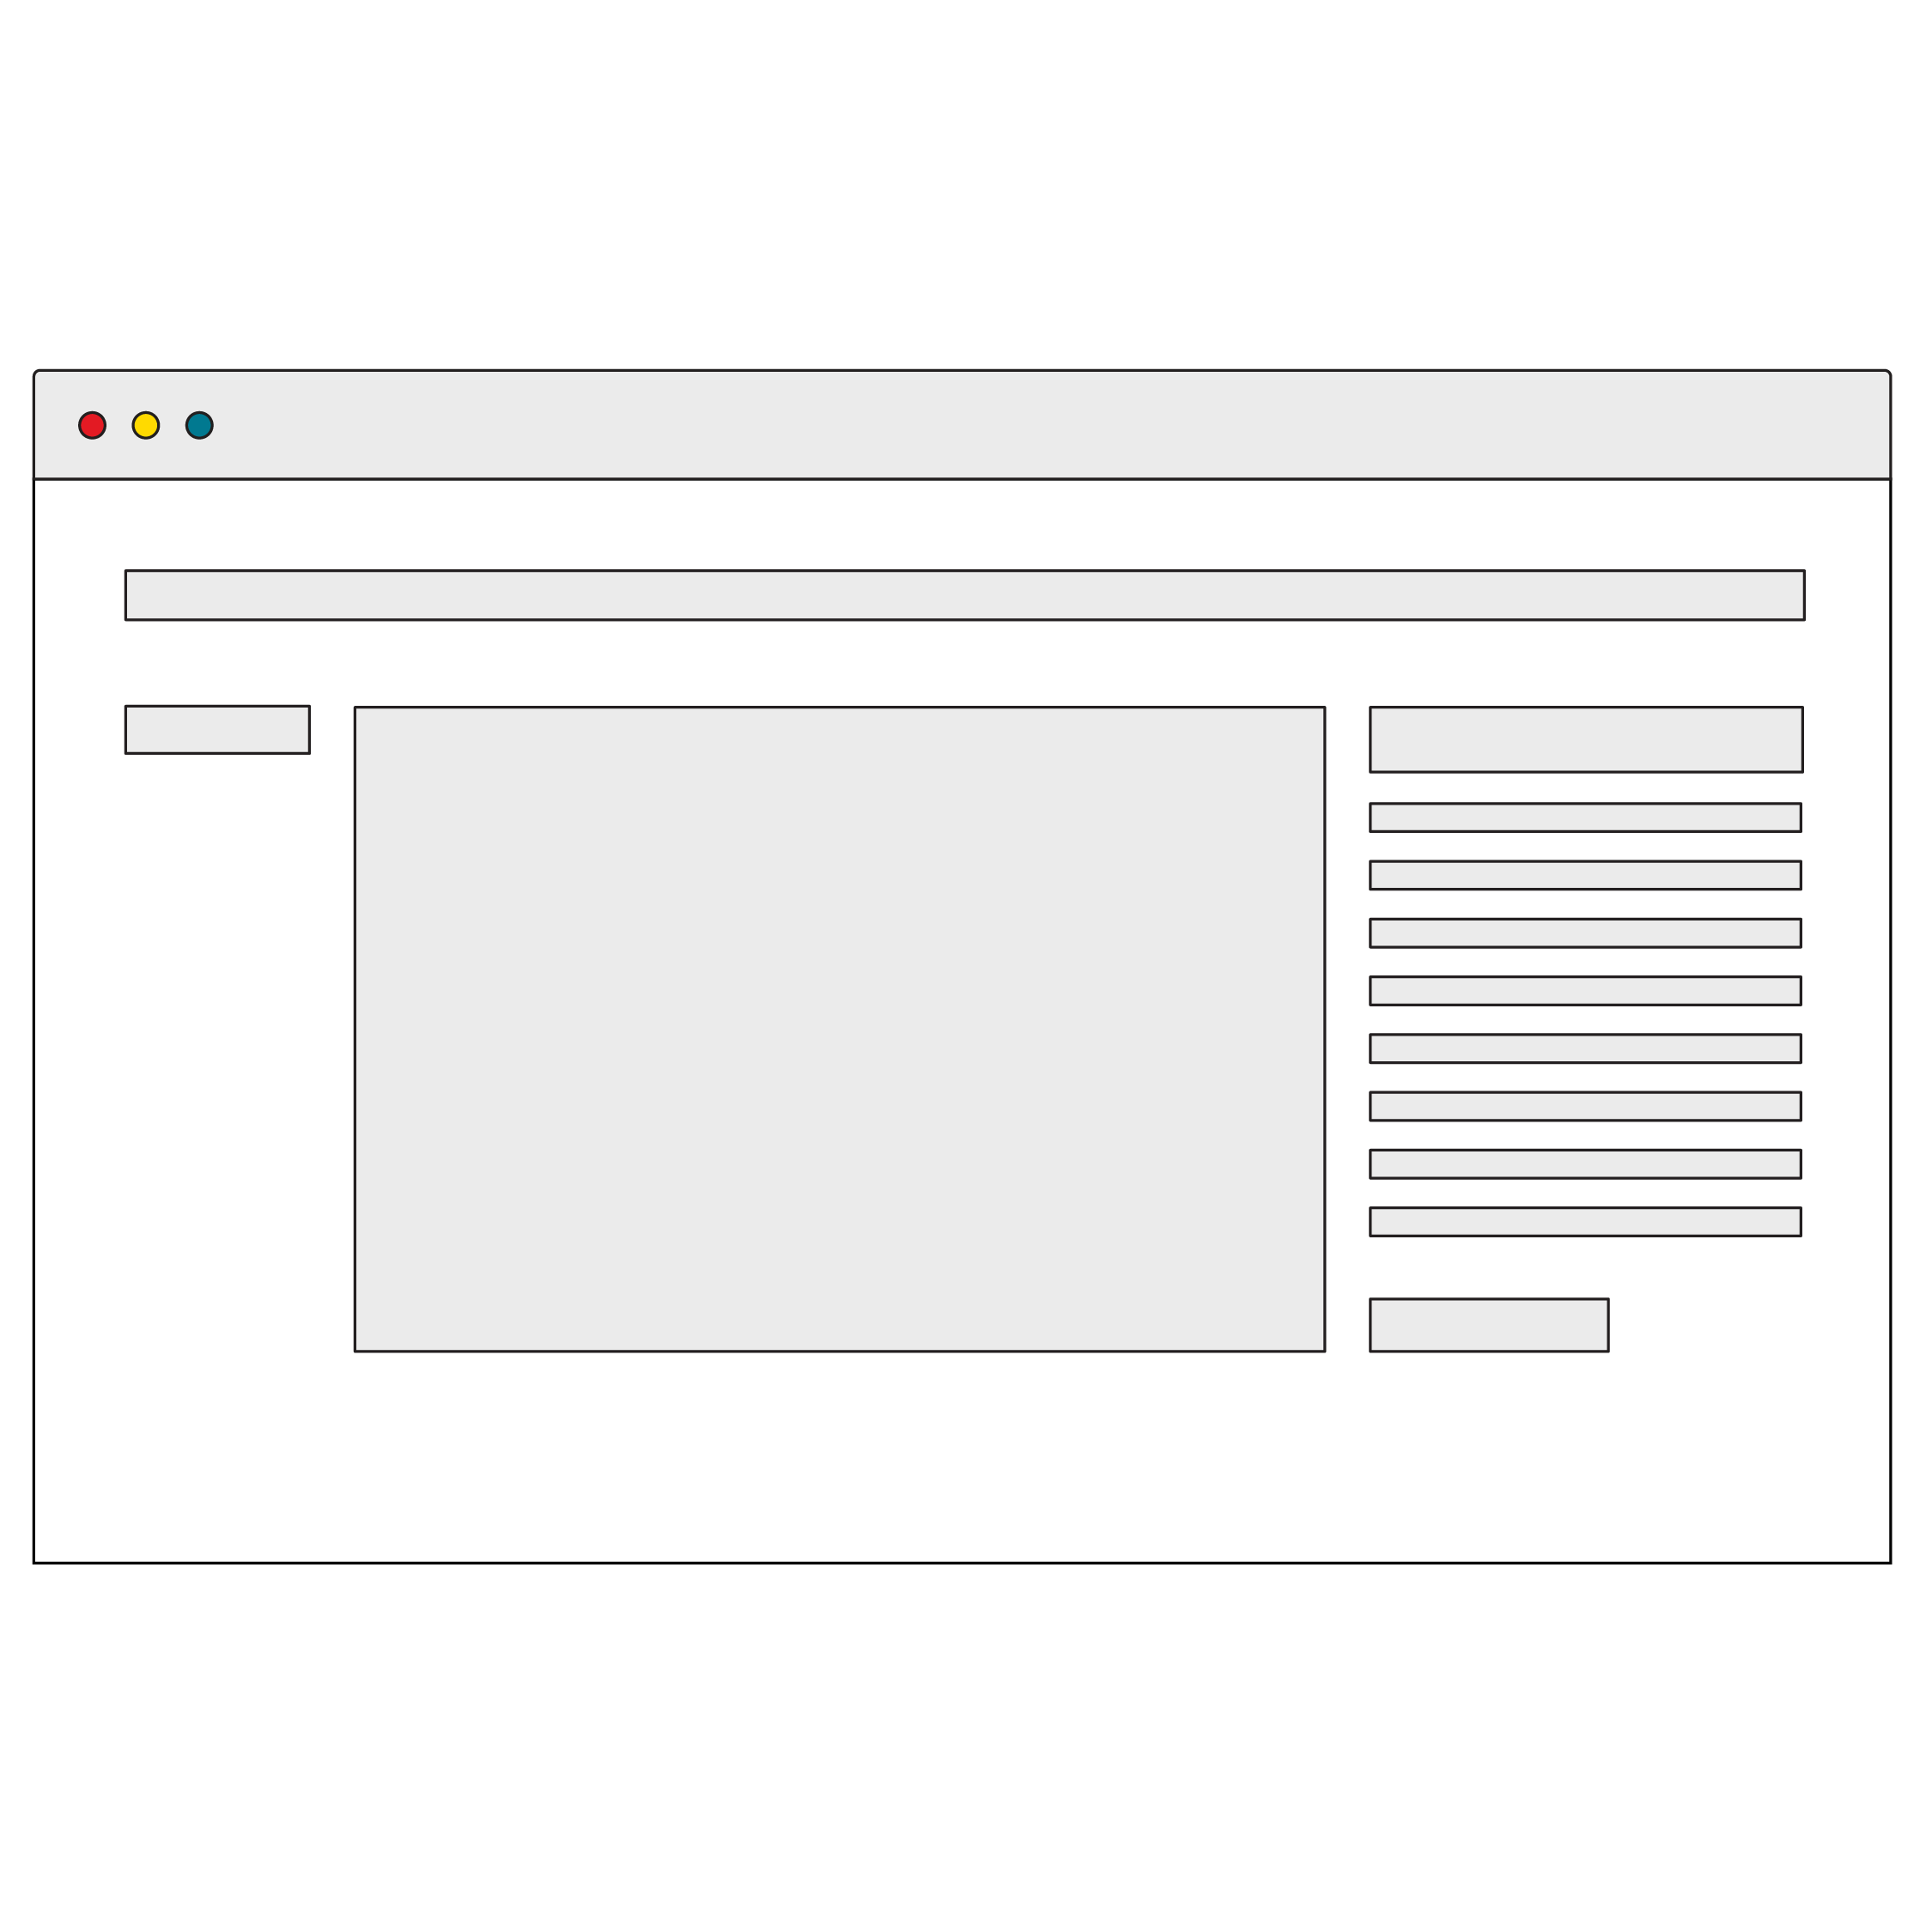
Wireframe Twice, Code Once
Wireframes are the blueprint for your site, app, or software.
They are medium- to high-fidelity representations of what users will see.
They’re a primary way to plan out your site before you start coding. In organizations, they’re critical to communicate design solutions across teams.
Notes:
PURPOSE: Define wireframes.
TALKING POINTS:
Analogy: If iterative sketches are a conversation you’re having with yourself, wireframes are a conversation you’re having with others.
Wireframes help us:
Think through systems.
Identify and (re)use patterns.
Get feedback from peers and users.
Refine UI details.
Wireframes can be extremely useful for remote teams.

Slide 28
Picturing HTML With WireFrames
<main>
<section class=”1”>
<p>
Content
</p>
</section>
<section class=”2”>
<p>
More content
</p>
</section>
</main>
p
section
p
section
main
Notes:
PURPOSE: Demonstrate wireframes in the context of HTML.
TALKING POINTS:
Note how <main> splits off into two “directions” with each section. Sections could split off with several children as well, as each “branch” can itself have many branches.

Slide 29

How is this page structured?
15 Minutes
Notes:
PURPOSE: Get students thinking about the HTML structure of webpages.
TEACHING TIPS:
Split students into groups and give them dry-erase markers. Have them wrestle with the problem.
If you’re using a projector and whiteboard, you could draw outlines around the parts of the page as students describe them. Once they’ve given each part an element, turn off the projector and reveal the HTML skeleton behind the site.
The biggest area students struggle with is seeing the need for containers. This is a good bridge into how CSS and box model work — set it up and you’ll hook them.
FOR REMOTE CLASSROOMS:
Inform students that they should be able to draw outlines over the image using the screen sharing option and annotation tools in Zoom.

Slide 30
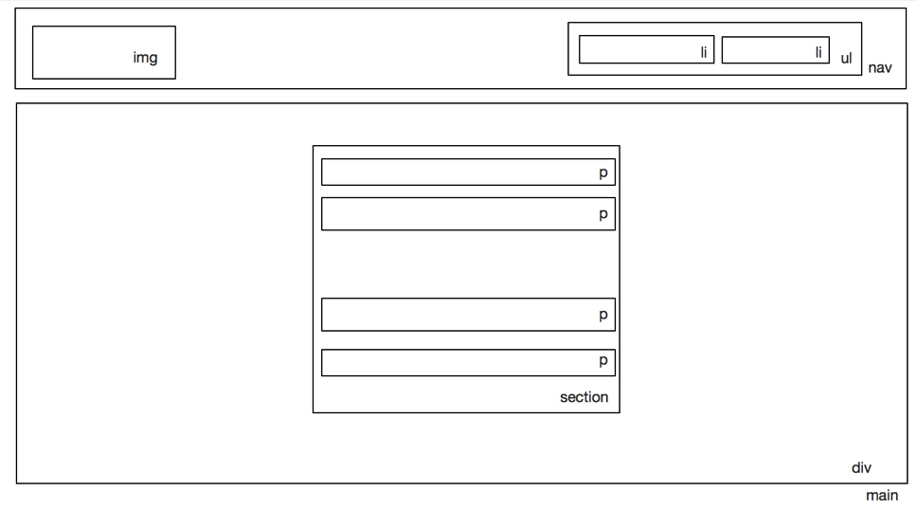
Remember: HTML Is Subjective (to Some Degree)
Notes:
PURPOSE: Show one of the answers to the exercise.
TEACHING TIPS:
This is just one answer to the previous slide’s question. If your class drew something different, that’s OK!
The content tags should have been much more agreeable than the container or semantic tags, which are where developers have to make more judgment calls on HTML elements.

Slide 31
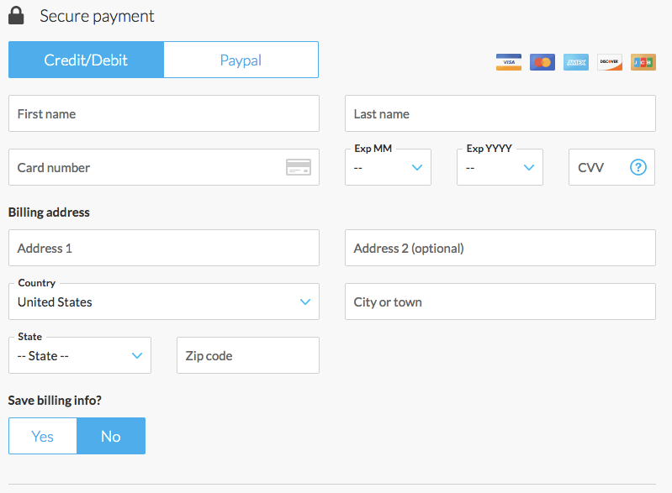
Websites Take on Many Forms...
Notes:
PURPOSE: Introduce HTML forms.
TALKING POINTS:
The whole point of front-end technology is to enable user interaction with a program via a website.
Forms are HTML elements that power complex user interactions beyond simple clicks.

Slide 32
Forms Reference
Reference the HTML for forms in the following CodePen:
Reference code:
https://codepen.io/GAmarketing/pen/592d34e48473087e5444d4dad31af7d2
Notes:
PURPOSE: Provide reference material for HTML forms that students can use in future exercises.

Slide 33

What Forms Do
Forms capture user input from the website and typically send it off to the back-end to be processed somehow.
Whenever you enter content into a webpage, you’re using a form!
Notes:
PURPOSE: Describe how HTML forms work.
TALKING POINTS:
Think of form submissions as the phone calls of the internet.

Slide 34
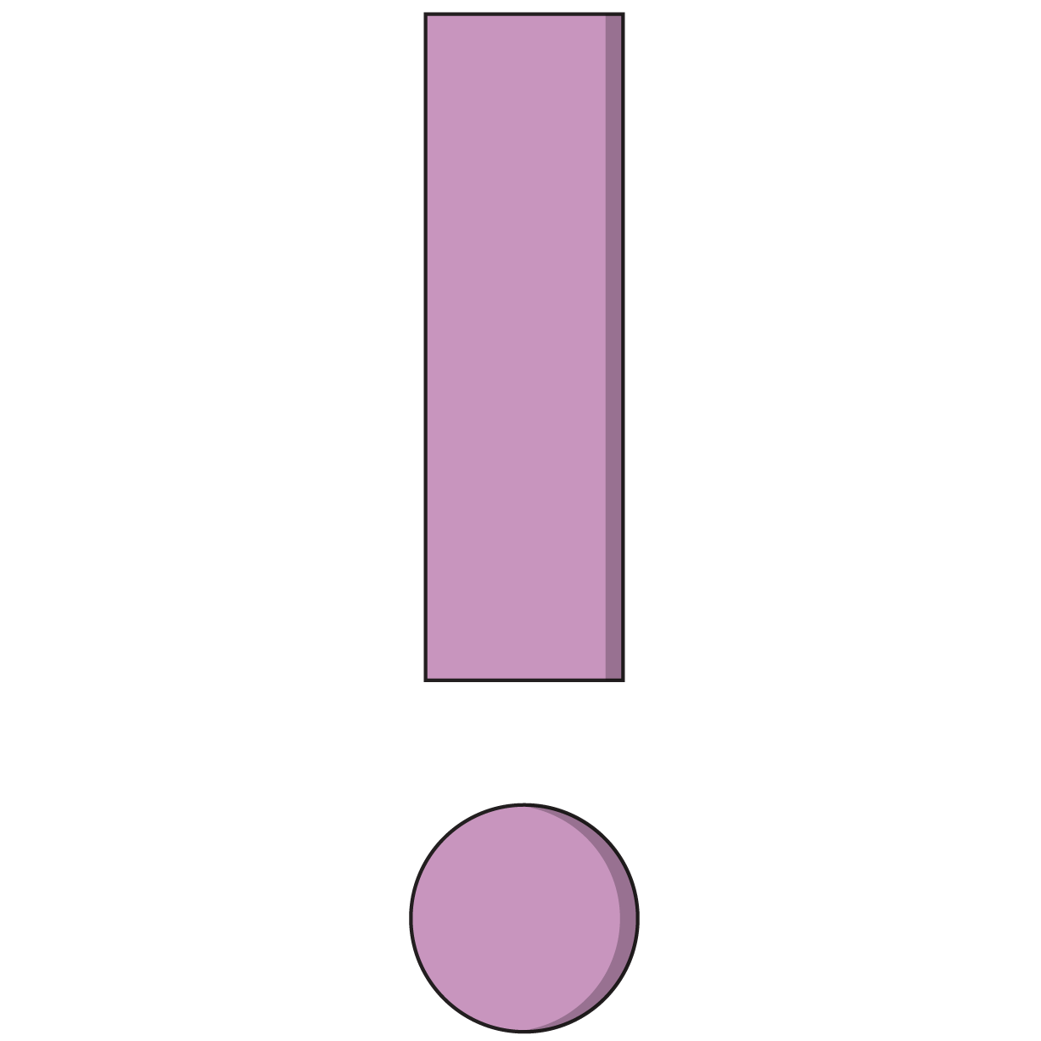
Simplest Form
<form>
<input type="text">
<input type="submit">
</form>
All forms have the form tag wrapped around them. Always include all components of your form within this tag.
Forms have a lot of markup and are tedious to build.
Notes:
PURPOSE: Show the basic structure of an HTML form.
TALKING POINTS:
There are many different styles and patterns of forms out there, so don’t expect one true way of creating forms. Only focus on the essentials: <form>, input, and submit.
A lot of CSS is spent taming form inputs.

Slide 35

The Wide, Wide World of Input Types
There’s a huge list of possible input types out there: https://developer.mozilla.org/en-US/docs/Web/HTML/Element/input.
Depending on how specific you want to get, the same form question could be represented with several different form inputs.
Once again, the world of programming presents us with a myriad of possibilities. We’ll focus on a few of the most important items that will allow us to master the patterns for all other types of inputs.
Notes:
PURPOSE: Note the possibilities for input types.

Slide 36
<input>
<form>
<legend>Form Title</legend>
<input type="text" id="username">
<input type=”number” id=”age”>
<input type=”submit” value=”Submit this form!”>
</form>
Notes:
PURPOSE: Define the input tag.
TALKING POINTS:
input is the workhorse of the form world. It can accept many types of user information depending on the type property it is given.

Slide 37
<label>
<form>
<fieldset>
<label for="username">Username:</label>
<input type="text" id="username">
<input type="submit" value="Submit this form!">
</fieldset>
</form>
Notes:
PURPOSE: Define the label tag.
TALKING POINTS:
label is the tag that indicates what an input represents.
The for attribute specifies which form element a label is bound to and uses the element’s id value as its means of making this distinction. This relationship provides some UI features, such as moving focus to the relevant input field when the label is clicked, tapped, or otherwise triggered.

Slide 38
The List
30 Minutes
As we advance through our front-end technologies, we'll apply them to a classic programming project: the to-do list website. This website will accept a user's input through a form and add that input to a list of other items they've created through the same form. At a minimum, we'll need:
A text input for the user to create new items.
A button for the user to click when they're ready to create a new item.
A list (fill in some placeholder items until we get the app working).
Some text telling the user what they're doing.
Let's start by drawing up a wireframe, then create the HTML in a fresh, new CodePen.
Notes:
PURPOSE: Students apply the HTML knowledge they’ve learned by building a to-do list website.
TALKING POINTS:
CodePen is a quick and easy way to get started with basic front-end coding. It also allows you to share your code with others.
Keep your to-do list CodePen open throughout the course, or create an account and save the Pen as you go.
TEACHING TIPS:
Encourage students to be creative and flexible in how they approach the to-do list project. It doesn't have to strictly adhere to the concept of a to-do list — it can be a ramen bowl creator app that lets users add ingredients to their order list, or a world tour planning app that lets users plan out a vacation by adding destinations to the list.

Slide 39
Wait… my HTML looks nothing like my wireframe!
So, you had a nice wireframe for an awesome app, only to discover that your HTML fell short. It happens!
We've officially reached the limitations of using only HTML. Anything but the most basic of layouts is going to require our new friend: CSS.
Notes:
PURPOSE: Transition into CSS by demonstrating how necessary it is in accomplishing the goal of matching the list site to the wireframe.

Slide 40
Styling With CSS
Intro to Coding Bootcamp
Building the Web With HTML
Styling With CSS
JavaScript Syntax
JavaScript in Action
Notes:
DURATION: 90 Minutes

Slide 41
What’s Next
Use CSS to apply styles to an HTML document.
‹#› | © 2020 General Assembly
Notes:
PURPOSE: Highlight the learning objectives for this section.

Slide 42
CSS Basics
As we introduce CSS, open this handy reference to the most basic selectors, properties, and values in a separate browser window.
Reference code:
https://codepen.io/GAmarketing/pen/QWWBpbB
‹#› | © 2020 General Assembly
Notes:
PURPOSE: Walk through the reference on CSS basics.
TEACHING TIPS:
Review the CSS properties and discuss their syntax and/or importance in how they’re used to build out designs. Use the code in the reference as an example when discussing the next slides.

Slide 43
CSS: Cool Style Stuff
No, CSS doesn't actually stand for Cool Style Stuff. We live in a more boring universe, where it stands for Cascading Style Sheets. Let's break it down:
Cascading: We can define style for a lot of elements, and CSS rules will trickle down from general to more specific ones.
Style: You've got it or you don't, and CSS has definitely got style.
Sheets: We can define our style across several documents, each with a .css file type.
Notes:
PURPOSE: Introduce and define CSS.
TALKING POINTS:
Large apps might have a universal, generic style sheet and more specific style sheets for each page or subsection.

Slide 44
The Anatomy of CSS
Selector
(What We Are Styling)
p {
color: blue;
font-size: 20px;
font-style: italic;
}
Declaration Block
(Our Styles)
Notes:
PURPOSE: Introduce the basics of CSS.
TALKING POINTS:
A CSS rule consists of a selector and a declaration block.
The selector points to the HTML element you want to style.
The declaration block contains one or more directions for how to style that element.
You can have several declarations for one element (font, size, color, alignment).
Each declaration is separated by a semicolon. A CSS declaration always ends with a semicolon.
Each declaration includes a CSS property name and a value.
Declaration blocks are surrounded by curly braces.

Slide 45
Properties
p {
color: white;
text-decoration: underline;
}
Properties are parts of the CSS spec that control style behavior. Most are logically named, but not all.
Properties will always be followed by a colon, then the value.
‹#› | © 2020 General Assembly
Notes:
PURPOSE: Define CSS properties.

Slide 46
Properties + Values
p {
color: white;
}
In this example, all p tags have their color property set to the value of white. This changes their font color to the given value.
You must have at least one property-value pair per selector (otherwise, nothing happens), and they MUST always end with a semicolon.
‹#› | © 2020 General Assembly
Notes:
PURPOSE: Illustrate CSS properties and values through an example.

Slide 47
Properties + Values (Cont.)
p {
color: white;
font-weight: bold;
padding: 15px;
text-decoration: underline;
}
You can have an unlimited amount of property-value pairs in a style declaration.
If you find that many declarations share the same property-value pairs, consider declaring those pairs in a more broadly targeted selector.
‹#› | © 2020 General Assembly
Notes:
PURPOSE: Illustrate CSS properties and values through an example.
TALKING POINTS:
If color:white is listed for 10 different elements in 10 different places, for example, that single rule should be in a single declaration impacting all 10 of the desired elements. That way, changing it to a different color throughout the site will be easier, and you’ll be less prone to “missing a spot.” This is a perfect use case for creating a class called .white.
TEACHING TIPS:
This can be a good opportunity to introduce the “Don’t Repeat Yourself” mantra.

Slide 48

There Is a Whole Universe of CSS Properties & Values
A good developer only has to know the planet they are on.
‹#› | © 2020 General Assembly
Notes:
PURPOSE: Note the infinite possibilities for CSS properties and values.
TEACHING TIPS:
Emphasize that attempting to memorize every CSS property and its possible values wouldn’t be a good use of time. Knowing the most commonly used ones and how to quickly research the less common ones when needed is the essential skill.

Slide 49
Important CSS Properties
Property Name | Description
background, background-color | The style behind an element; can be images, colors, or gradients.
border | Styles the edges around an element.
color | Sets the color of text, NOT the background color.
font | Controls font family, size, style, and weight.
height, width | Sets how tall or wide an element should be in px, %, or ems.
margin | Creates space outside of an element.
padding | Creates space on the inside border of an element.
text-align | Defines the direction that text lines up in an element.
‹#› | © 2020 General Assembly
Notes:
PURPOSE: Identify some of the most essential CSS properties.
TALKING POINTS:
Of course, there are more or less on each developer’s individual list, so these are by no means the most important CSS properties.
TEACHING TIPS:
Reiterate that students will get a sense for which ones are important based on what they’re seeing and using the most often when inspecting sites on their browser.

Slide 50
What Styles Look Like
5 Minutes
p {
color: white;
text-decoration: underline;
}
What are the individual parts of this CSS rule?
How do you think we could change or extend them?
What other style changes do you think we could make?
‹#› | © 2020 General Assembly
Notes:
PURPOSE: Lead a discussion on CSS rules and allow students to apply what they’ve learned so far.
TALKING POINTS:
Which one is the selector? Value? Property?
FOR REMOTE CLASSROOMS:
Create a thread in Slack for each question and solicit suggestions for what other selectors, values, or properties there might be.

Slide 51
Class & ID Attributes
Remember when we said HTML elements can have attributes, like the source of an image or the href of a link? Well, there are two important attributes that help us target specific elements with our CSS rules:
Classes are used to share styles among several different elements.
Example: <p class="red-text">I should be red</p>
IDs are used to define a single, unique element for individual styles.
Example: <h1 id="main-headline">I'm very important</h1>
Notes:
PURPOSE: Introduce the main attributes used in CSS selectors that are necessary for effective styling.

Slide 52
Selectors & Specificity: Elements < Classes < IDs
Selectors tell the browser which elements should be impacted by the style. CSS rules are applied in order of specificity.
Element selectors
The least specific selectors; apply to all elements of the given tag type.
Syntax is simply the name of the element: h1.
Class selectors
Apply to all elements with the chosen class attribute.
Syntax starts with a dot, followed by the name of the class: .className.
ID selectors
Apply to all elements with the given ID attribute.
Syntax starts with a hashtag, followed by the name of the ID: #idName.
‹#› | © 2020 General Assembly
Notes:
PURPOSE: Introduce selectors.
TALKING POINTS:
Selectors put the “cascade” in cascading style sheets. Rules can be as broad or specific as you make them, and more specific rules beat less specific ones.
Many CSS “bugs” are caused by specificity conflicts.

Slide 53
Multiple Selectors
p, .class-name {
color: white;
text-decoration: underline;
}
You can have...
Two selectors together, mixing HTML elements and custom classes if you want. The example above targets p tags and any element with the class name .class-name.
An unlimited number of selectors — just separate each new selector with a comma.
‹#› | © 2020 General Assembly
Notes:
PURPOSE: Introduce the concept of multiple selectors.
TALKING POINTS:
Using multiple selectors is especially effective when the same type of style is repeated throughout a site. If you ever want to change the color, for example, you would typically be changing it in all other places where the same color was chosen as part of altering the theme of the site.

Slide 54
Parent Selectors
.sidebar p {
color: white;
text-decoration: underline;
}
You can target elements according to their specific parent element by separating two selectors with a space. The example above targets all p tags contained within an element having the class of .sidebar.
There are also other selectors, called combinators, that target elements based on their specific relationships to other elements.
‹#› | © 2020 General Assembly
Notes:
PURPOSE: Define parent selectors and introduce combinators.
TALKING POINTS:
Parent selectors are commonly used to target specific areas of a site. Targeting an element based on its path adds to its specificity and increases its weight when compared to other rules applied to the same type of element.
Find out more about combinators here: https://www.w3schools.com/css/css_combinators.asp.

Slide 55
Selectors Targeting Multiple Attributes
div.my-class {
color: white;
text-decoration: underline;
}
You can also combine several selectors together in order to target only the elements that match all of the selectors included. The example above targets only div elements with the .my-class class.
Notice that there is no space between div and .my-class.
‹#› | © 2020 General Assembly
Notes:
PURPOSE: Show how to target multiple attributes using selectors.
TEACHING TIPS:
Explain that a series of selectors connected without a space are all targeting the same element. The subtle difference between this and the parent selector can easily cause unintended behavior.

Slide 56
General Selectors
Specific Selectors
Cascade Throughout HTML
Hit Limited Amount of Elements
Using selectors that are generic — i.e., represent a “trunk” of the tree — will result in styles that cascade and affect many elements.
Good uses: Color themes, font styles, and other stylistic elements repeated throughout the site.
Classes and IDs are useful for styles that are only applied in small, limited sections of the website.
Good uses: The spacing and placement of individual elements and styling of non-repeated elements.
‹#› | © 2020 General Assembly
Notes:
PURPOSE: A high-level conceptual comparison between different selector strategies, encouraging students to choose thoughtfully when declaring attributes and selectors.

Slide 57
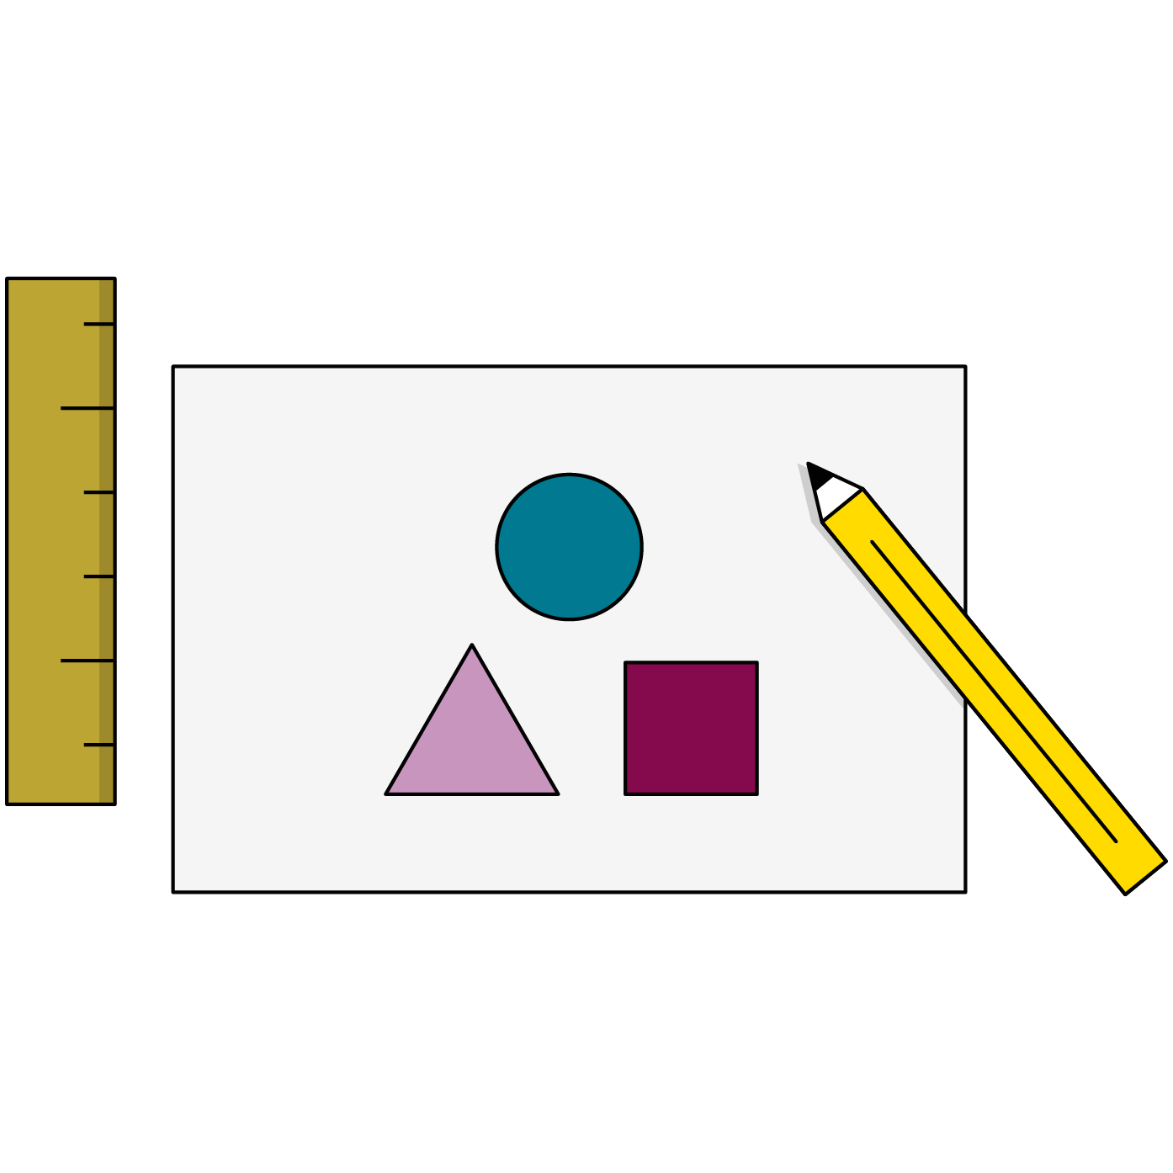
Quick Styling Tips
Always put a new style on a new line.
Try to alphabetize your styles or organize them logically by section.
Use external style sheets that are linked in the head of your HTML document.
Use whitespace so people can read your code.
Comments are welcome in your CSS.
‹#› | © 2020 General Assembly
Notes:
PURPOSE: Provide some tips for organizing CSS documents before students begin creating them.

Slide 58
Explaining CSS Selectors
15 Minutes
Walk through the following examples and take turns explaining what the selector, property, and values are for each item.
Starter code:
https://codepen.io/GAmarketing/pen/ZEEjeWZ
Solution code:
https://codepen.io/GAmarketing/pen/vYYaxKx
‹#› | © 2020 General Assembly
Notes:
PURPOSE: Give students the opportunity to apply their knowledge of CSS properties and selectors.
TEACHING TIPS:
You can also encourage students to make changes to the rules and see what happens — experimentation will be key to exploring these early concepts.

Slide 59
Layouts Love CSS
As we saw with our sad list application, HTML layouts really need CSS.
Two essential components of CSS help us lay out our elements:
The box model properties help us adjust the size and spacing of our individual HTML elements.
The display property lets us arrange things on a bigger level. Should an element stack on top of its neighbor, or sit nicely next to each other?
Notes:
PURPOSE: Establish the need for the display and box model properties by grounding them in the project at hand.

Slide 60
The Box Model
margin-top
border-top
padding-top
width
background-color
margin-left
border-left
padding-left
height
padding-right
border-right
margin-right
padding-bottom
border-bottom
margin-bottom
Notes:
PURPOSE: Introduce the box model.
TEACHING TIPS:
Open up Chrome Inspector on a website and reveal its box-model highlighting feature. Explain the colors behind the box model and how you can play around with the values right there in Inspector. Hopefully, students are getting used to using the Inspector frequently as they code.
You should also explain how margin or padding shorthand declarations go clockwise around the box. Draw that out for the class.

Slide 61
Box Model Basics
Every block-level element on a webpage is a box.
Block elements have a padding, border, and margin.
width + padding + border = actual width of an element's box.
height + padding + border = actual height of an element's box.
margin is outside the box and does NOT count toward height and width.
margin-top
border-top
padding-top
width
border-right
padding-left
margin-right
margin-left
height
padding-right
border-left
padding-bottom
border-bottom
margin-bottom
Notes:
PURPOSE: Discuss each level of the box model.
TEACHING TIPS:
Tell students that if they want to "push" an element on the page, they should use margin on the element they want to move around. If they want to make an element "bigger," padding is the appropriate way to add space inside an element.

Slide 62
display
"display" controls the behavior of the box in which content sits. We’ll cover several of the most commonly used values of the display property:
block
inline
inline-block
none
Notes:
PURPOSE: Introduce the display attribute and the aspects we’ll cover.

Slide 63
Block vs. Inline Elements
Block-level elements inherit the box model.
div, section, ul, nav, header, footer
Inline-level elements do NOT inherit the box model.
span, img, sub, sup, textblock
You can apply display: block; to an inline element via CSS and it will become a block-level element (and vice versa).
Refer here for a list of inline elements: https://developer.mozilla.org/en-US/docs/Web/HTML/Inline_elements.
Notes:
PURPOSE: Delineate between block and inline elements.
TALKING POINTS:
Using Inspector is crucial for figuring out which elements are block versus inline when you’re first starting out; it can be tough to know.

Slide 64
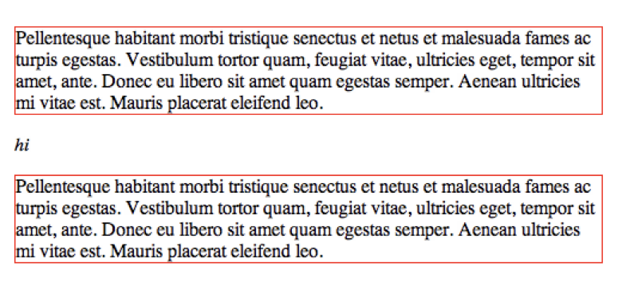
Positioning Elements: block
display: block;
This element takes up as much width as possible, and the following element drops to a new line.
Image Source; css-tricks.com
Notes:
PURPOSE: Illustrate an example of the block display type.

Slide 65
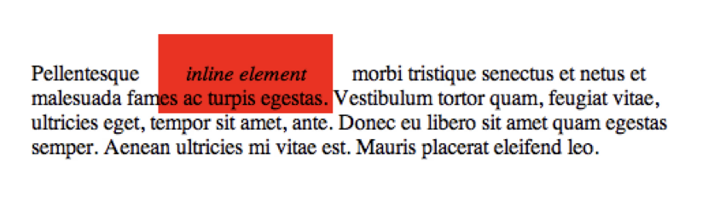
Positioning Elements: inline
display: inline;
This element takes up only as much width as it needs. Padding and margins only work for left and right, not top and bottom.
top and bottom spacing is controlled by the line-height property because the content is inline.
Image Source; css-tricks.com
Notes:
PURPOSE: Illustrate an example of the inline display type.

Slide 66
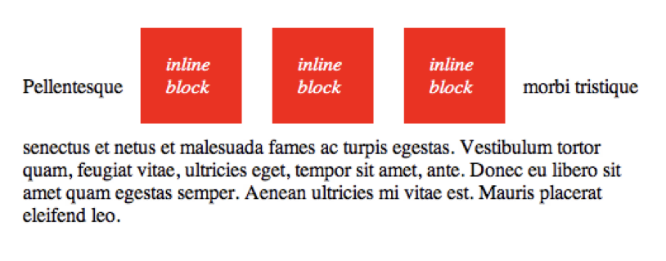
Positioning Elements: inline-block
display: inline-block;
This combines the two concepts.
Inline blocks display inline with other items but allow you to use all margin, padding, height, and width properties.
Image Source; css-tricks.com
Notes:
PURPOSE: Illustrate an example of the inline-block display type.

Slide 67

Positioning Elements: none
display: none;
Nothing shows up at all. It's in the DOM the browser sees, but the user won't see it. You can use Chrome DevTools to see the browser’s view.
This may seem useless now, but just wait until we hit JavaScript — you're going to love display: none.
Image Source; css-tricks.com
Notes:
PURPOSE: Illustrate an example of the none display type.
TALKING POINTS:
Question: If we don’t want something to be visible, why even put it in the HTML at all?
Answer: We can use JavaScript to make it visible later on and do the opposite to hide elements by giving them display: none as well.

Slide 68
Practicing the Box Model
45 Minutes
Draw an HTML tree diagram to help lay out this page: https://s3-us-west-2.amazonaws.com/s.cdpn.io/2522641/wireframe-basic.pdf.
In a new CodePen, create the HTML structure of the page, including placeholder images. Use <div> or <section> elements as containers for the different parts of the site.
Apply the box model CSS properties to the HTML. Adjust the box model to test what happens.
Adjust the display property to achieve the correct alignment of elements.
Notes:
PURPOSE: Give students the opportunity to apply their knowledge of the box model and display types.
TEACHING TIPS:
This could be a partial code-along/self-guided activity. Demonstrate the solution one piece at a time, then after about 15 minutes, check on the header section. After 30 minutes, check on the image gallery, and so on.
This exercise may be beyond what students can do. Check in on students, support them, and encourage them to push into new material.

Slide 69
Box Model Solution
Below is just one example of solution code for the layout exercise.
Solution code:
https://codepen.io/GAmarketing/pen/GRjdBMb
Notes:
PURPOSE: Walk through the solution of the box model exercise.
TEACHING TIPS:
The solution example isn't perfect, and you can point out the breakpoints or limitations of the code to encourage students to continue exploring better ways of producing layouts in CSS. However, this solution uses what we know so far, and provides good repetition of our basic styles.

Slide 70
Styling Our To-Do List's Layout
15 Minutes
Now that we've got CSS to create our layouts, let's return to our list app and help the HTML match the wireframe. Once you've finished the layout, add as much style to the app as you'd like to help achieve your vision.
Note: You’ll probably not achieve your vision — and that’s OK! Behind every successful developer is a mountain of embarrassing early projects.
Notes:
PURPOSE: Give students the opportunity to apply their CSS knowledge to their to-do list app.
TEACHING TIPS:
Reiterate fundamental layouts concepts (e.g., "Block will block anything else from sharing space, while inline-block lets things sit next to each other.").
Students will likely struggle with container elements that aren't necessarily visible on the page, so get them thinking about creating divs and sections when elements need to be laid out together.

Slide 71

Time for Lunch!
Customize It!
Notes:
DURATION: 60 Minutes
Customize it! If you’d like, replace with your favorite GIF or image related to food or eating. :)

Slide 72
Lunch Activity
Activity + Debrief Guide
Students can apply more styles to their to-do list application if they want to continue working during the lunch break.
Encourage them to explore things like font styles, background colors, and other properties that will help them customize their application.

Slide 73
JavaScript Syntax
Intro to Coding Bootcamp
Building the Web With HTML
Styling With CSS
JavaScript Syntax
JavaScript in Action
Notes:
DURATION: 60 Minutes

Slide 74
Our Goal for This Section
Understand fundamental JavaScript syntax.
‹#› | © 2020 General Assembly
Notes:
PURPOSE: Highlight the learning objectives for this section.

Slide 75
The Goal of JavaScript
Fundamentally, JavaScript is on the web to make things happen.
Most of the time, this can be boiled down to the following steps:
Show the user a webpage they can interact with.
Wait for the user to interact with the webpage.
Once the user does something, respond by running JavaScript code.
Update the webpage to show the user what has happened.
Notes:
PURPOSE: Set up a conceptual framework for web apps to place JavaScript clearly in the context of front-end development.

Slide 76
Variables
Functions
The Nouns of Programming
The Verbs of Programming
Pieces of data in a program that can be used and changed many times.
These are used for anything you need the computer to remember or keep track of for later. If you would write it down, it’s a variable.
Modular, reusable sets of steps for the computer to perform.
These allow us to define building-block procedures that provide readable instructions for complex operations.
‹#› | © 2020 General Assembly
Notes:
PURPOSE: Simplify JavaScript to its absolute essentials so students can use it for web interactions later.
TALKING POINTS:
Elements or objects will be variables, and events will trigger functions.

Slide 77
Variables
Variables allow us to store data in a program.
You can declare variables using the let or const keywords.
const, short for “constant,” is for variables that won’t be assigned new values.
let is for variables that will be given new values, as when using math, for example.
You can refer to variables by using their names anywhere in your program.
const seasonsInAYear = 4;
let websitesBuiltByMe = 0;
Notes:
PURPOSE: Establish how to create variables and store information in JavaScript.

Slide 78
Variable Naming
Names should be easily understood.
No spaces allowed.
You can use "_", but don’t do it.
Use camelCase: itWorksLikeThis.
let totalPrice = 18;
const midWeek = "Wednesday";
Notes:
PURPOSE: Establish conventions for naming variables in JavaScript.
TALKING POINTS:
camelCase is the standard used for naming variables in JS. Other languages such as Ruby use the underscore to separate words_in_a_name.

Slide 79
Messages & Alerts
// Writes to webpage
document.write("Yes!");
// Writes to console
console.log("Houston, do you copy?");
// Makes dialog boxes pop up
alert("You destroyed the computer again.");
Notes:
PURPOSE: Introduce console.log so students know to use it for debugging purposes.
TALKING POINTS:
The console will be your main method of "communicating" with your JS code.

Slide 80
Operators in JS
Operator | Description | Example
+ | Addition | let number = 1 + 1;
- | Subtraction | let luckyNumber = 10 - 3;
* | Multiplication | let nine = 3 * 3;
/ | Division | Let dividedNumber = 13 / 7;
= | Assignment | Let newValue = 10;
=== | Equality | newValue === 10; // will equate to true or false
Notes:
PURPOSE: Introduce JavaScript operators.
TALKING POINTS:
These symbols are the building blocks for JS syntax. The only tricky one is assignment versus equality.

Slide 81
Variable Reassignment
let x = 18;
console.log(x);
⇒ 18
x = x * 2;
console.log(x);
⇒ 36
Note: If you used const instead of let to declare the variable, that last part would throw an error.
Notes:
PURPOSE: Illustrate the concept of variable reassignment.
TALKING POINTS:
Just doing * or + won’t actually change the value. Using the assignment operator (= sign) is what overwrites a variable’s current value to a new value. You could also write += as a shortcut.

Slide 82
Birthday Magic
10 Minutes
In this starter code, we continually update a variable that will eventually, by math magic, reveal your birthday! Make the updates to the variable as requested by the comments in the code, and use console.log to keep track of progress.
Starter code:
https://codepen.io/GAmarketing/pen/xxErXrb?editors=0011
Notes:
PURPOSE: Get students acquainted with basic JS operations by having them continually modify a variable. This should help build repetition with the concept of declaring and updating variables.

Slide 83
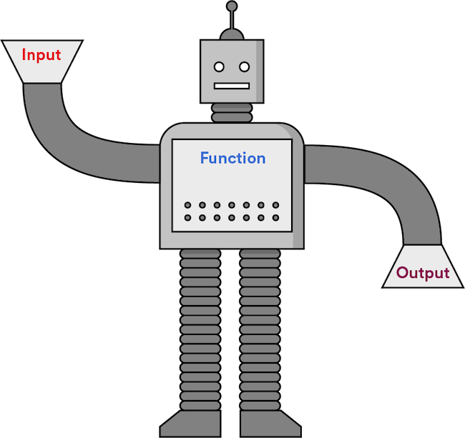
Functions
Functions are chunks of code that are grouped and execute together, like a modular program within a program.
A function takes input, performs logic, and returns output.
Notes:
PURPOSE: Introduce the concept of functions.
TALKING POINTS:
We just saw functions on the last slide: console.log and friends take in a message and do something with it.

Slide 84
Functions (Cont.)
Reusable functions need names and follow naming rules identical to those of variables.
They must be called or “invoked” to execute and return a value.
They accept input, called parameters, that can be used inside the function.
function createGreeting(name) {
return "Hello there, " + name;
}
const customGreeting = createGreeting(“Nahid”);
console.log(customGreeting)
Notes:
PURPOSE: Demonstrate JavaScript function syntax.
TALKING POINTS:
These are the sets of instructions we will later be able to trigger when users perform actions with our HTML.
TEACHING TIPS:
Spend some time with basic function challenges, demonstrating the power and problem-solving capability of functions.

Slide 85
Fun With Functions
30 Minutes
Here, we have a few function-writing challenges. Don't be afraid to Google any questions about how to do something in JavaScript. Developers rely on their quick research skills to solve problems, not on memorizing everything.
Starter code:
https://codepen.io/GAmarketing/pen/OJRgvPo?editors=0011
Solution code:
https://codepen.io/GAmarketing/pen/QWKrVwM?editors=0010
Notes:
PURPOSE: Give students the opportunity to create JavaScript functions on their own and research what they don’t know.
TEACHING TIPS:
Continue encouraging students to Google their questions to learn more useful things in JavaScript.

Slide 86
JavaScript (JS) in Action
Intro to Coding Bootcamp
Building the Web With HTML
Styling With CSS
JavaScript Syntax
JavaScript in Action
Notes:
DURATION: 120 Minutes

Slide 87
Our Goal for This Section
Use JavaScript to respond to user interactions on a webpage.
‹#› | © 2020 General Assembly
Notes:
PURPOSE: Highlight the learning objectives for this section.

Slide 88

What does JavaScript (JS) really do?
JS responds to user actions, called events, to change the HTML content or CSS styles of a webpage.
JS loads data from and sends data to servers, databases, and other websites.
JS programs complex instruction sets like algorithms, machine learning, and more.
Notes:
PURPOSE: Establish how JS is actually applied in practice to connect the previous concepts to more concrete objectives.

Slide 89
JS on Your Webpage
Intro to Coding Bootcamp

Slide 90
A Webpage Is One Giant JS Object
Window
Document
Console
Notes:
PURPOSE: Define a JavaScript object.
TALKING POINTS:
Objects can be intuitively understood for what they are: things in JavaScript.
Objects have properties and methods, like your computer: It has a color, size, and brand, but it also has the ability to do things like turn on, change the screen brightness, and so on.

Slide 91
Everything you see in the browser is a
JS object.
‹#› | © 2020 General Assembly
Notes:
PURPOSE: Make a strong connection between HTML and JavaScript by understanding that HTML elements are represented in JavaScript as DOM elements or objects.

Slide 92
Three Big Objects
Window
Document
Console
The whole web browser; mostly used for browser-level settings.
The current webpage. This object has the functionality we want to use when accessing elements on the page.
A scratch pad for development-related messages; highly useful in debugging.
Notes:
PURPOSE: Define the main JavaScript objects on a webpage.
TALKING POINTS:
We'll be using the document object to grab specific elements and manipulate the current page.
We've already been using the console object without even knowing it (through console.log()), so connecting that syntax with document.querySelector() can be effective.

Slide 93
The DOM
Browsers read your HTML and create an object in the computer’s memory for each part. That HTML layout is called a “data model” because it describes the structure of your webpage.
The Document Object Model (DOM) is the browser’s JavaScript representation of your HTML elements.
Notes:
PURPOSE: Describe the DOM.
TEACHING TIPS:
Open DevTools and type in the word “document” to see what’s returned. Getting students comfortable with exploring, especially in DevTools, is key to continuing their learning after the workshop.

Slide 94
Object Properties
Objects have information that describe them (height, width, classes, etc.). These pieces of information are called properties.
Property | Description
someElement.classList | A list of the classes belonging to a DOM element.
someElement.id | The ID of an element, if it has one.
someElement.style.color | The color of an element’s text.
someElement.style.height | The height of an element.
Notes:
PURPOSE: Introduce the idea of properties for objects.
TEACHING TIPS:
Students may recognize some of these properties as HTML attributes or CSS properties. Emphasize the concept of key-value pairs throughout programming.

Slide 95
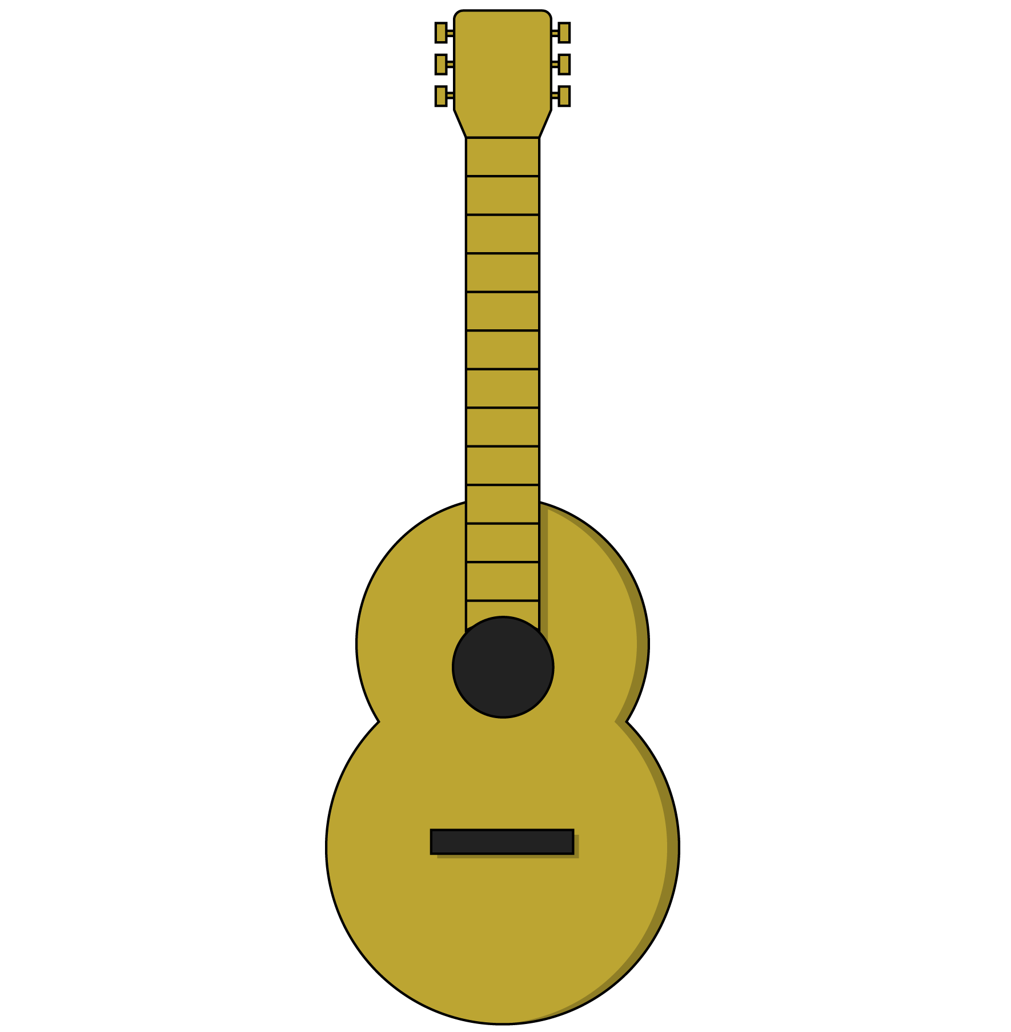
Methods
Methods belong to JavaScript objects, including DOM elements.
Think of methods as the functions an object can use. A guitar, for example, might have the following methods:
guitar.playChord(chord)
guitar.playNote(note)
guitar.changeTempo(tempo)
guitar.changeVolume(volume)
Notes:
PURPOSE: Set up methods in preparation for DOM manipulation methods.

Slide 96
What does a real piece of code look like?
document.querySelector(‘#ga’);
Object
Method
Parameter
Notes:
PURPOSE: Bring together the concepts of objects and methods through a code example.
TALKING POINTS:
This line of code gets the element with an ID of ga from the DOM. It would return an object — our DOM element — that we could then manipulate.
The querySelector method accepts a CSS selector and returns the first matching DOM element.

Slide 97
Query Selector
QuerySelector will be our main method for getting specific elements.
const gaData = document.querySelector(‘#ga’);
// querySelector grabs the first element matching the given selector
Now that we have our element, gaData, we can access and set its properties:
gaData.style.color = "red";
gaData.innerText = "My text was defined by JavaScript!";
gaData.className = "new-class";
Notes:
PURPOSE: Provide concrete examples of using the querySelector method to get elements from the DOM and how to set their properties.
TEACHING TIPS:
You can also make the strong connection between JS and CSS, given that JS is using CSS language to target specific elements.

Slide 98
An Element Is Born
Creating and adding new DOM elements is critical to providing interactivity. We use two methods — createElement and appendChild — to do this:
// create a new element and set its text property
const newParagraph = document.createElement("p");
newParagraph.innerText = "A surprising new message!";
// add the new element to a parent element
const mainTextElement = document.querySelector("#main");
mainTextElement.appendChild(newParagraph);
Notes:
PURPOSE: Set up how to add new elements to the DOM, which students can then use in their to-do list project.
TALKING POINTS:
The main methods we'll need for the list are querySelector, createElement, and appendChild. There are hundreds of methods you'll rarely ever need and a half-dozen methods worth memorizing.

Slide 99
DOM Reference Code
Let’s look at some DOM properties and methods in action. There’s no need to feel overwhelmed by details — the patterns are what matter.
Reference code:
https://codepen.io/GAmarketing/pen/jOEVBvv?editors=1010
‹#› | © 2020 General Assembly
Notes:
PURPOSE: Walk students through a few DOM properties and methods.
TEACHING TIPS:
Take your time going through this section. Use it to change stuff around and show students what’s possible.

Slide 100
Setting Up To-Do List Functions
30 Minutes
To set up the functionality of our to-do list, we need to write a few functions that use our new DOM element capabilities.
Starter code:
https://codepen.io/GAmarketing/pen/ZEpoMqw?editors=1011
Solution code:
https://codepen.io/GAmarketing/pen/BaLxOGm?editors=1011
Notes:
PURPOSE: Give students the opportunity to apply what they’ve learned on JavaScript objects and DOM manipulation methods.
TEACHING TIPS:
During the activity, check every 10 minutes for progress on the first, second, and third functions. Be prepared to walk through each example as students progress through the functions.

Slide 101
Event Handling
Intro to Coding Bootcamp

Slide 102
Events & Listeners
Anytime a user interacts with a webpage, the browser classifies that action as an event.
In our JS code, we can listen for events in the browser and trigger functions in response using event listeners.
// When object is clicked, the action function is called object.addEventListener(‘click’, action)
Notes:
PURPOSE: Introduce events and event listeners.
TALKING POINTS:
Mouse or finger movements on the screen, clicks, hovers, and key presses are all considered events in JavaScript.

Slide 103
Get, Set, Then Listen
We’ll often get an element and then set an event listener on it. Once the event occurs, the listener will execute the function it was given.
const ga = document.querySelector(‘#ga’);
function sayHello() { console.log(“hello!”);
} ga.addEventListener(‘click’, sayHello)
Notes:
PURPOSE: Introduce the concept of getting an element and setting an event listener on it.
TEACHING TIPS:
Emphasize that this is another repeated pattern throughout DOM manipulation: Get the thing we want, then set some aspect of it according to what we want to do with it.

Slide 104

Events To Listen For
5 Minutes
Click is the most common, but what other events might we want to listen for?
Notes:
PURPOSE: Lead a discussion on possible events to listen for in JavaScript.
TEACHING TIPS:
Hopefully, answers lead you to some of the following: hover, key press, key down, key up, focus, scroll, select, submit.
Try testing out some of the most common event types: https://www.w3schools.com/js/js_htmldom_events.asp.

Slide 105
Color Switcher
30 Minutes
In this exercise, we’ll use our new event-listening skills to create a color switcher.
Bonus: Try adding more switcher elements that change more colors.
Starter code:
https://codepen.io/GAmarketing/pen/dyPOWgd
Solution code:
https://codepen.io/GAmarketing/pen/xxbRdQr
Notes:
PURPOSE: Apply DOM manipulation and event listening in a more straightforward, well-set-up situation before asking students to apply them to their list application.

Slide 106
The End of the List
30 Minutes
Now it all comes together: We can attach an event listener to our to-do list buttons and use it to power the interaction behind our list application.
Use the same functions we previously set up to add new items to the list.
Notes:
PURPOSE: Get students to apply DOM manipulation and event listening to their to-do list application.

Slide 107
Key Takeaways
For Further Study
Everything Is JavaScript
JavaScript Practice
HTML elements are represented as objects in the DOM.
DOM objects have getters and setters to manipulate properties.
Event listeners attach to objects and use functions to respond to user actions.
We learned a lot of new concepts, but JavaScript stands out as the most difficult to get comfortable with.
‹#› | © 2020 General Assembly

Slide 108
Bring It Home
Intro to Coding Bootcamp

Slide 109
Where We’ve Been
Today, we covered:
The roles of HTML, CSS, and JavaScript in web development.
Creating a well-structured HTML document using elements and attributes.
Using CSS to apply styles to an HTML document.
Fundamental JavaScript syntax.
Using JavaScript to respond to user interactions on a webpage.
Building the Web With HTML
Styling With CSS
JavaScript Syntax
JavaScript in Action
Notes:
PURPOSE: A recap of what we covered.

Slide 110

Feedback, Please (and Thank You)
A survey will be sent to you within 24 hours. Please keep an eye out for it and let us know what you liked about this class and what we can improve.
Thank you!

Slide 111
Questions?

Slide 112
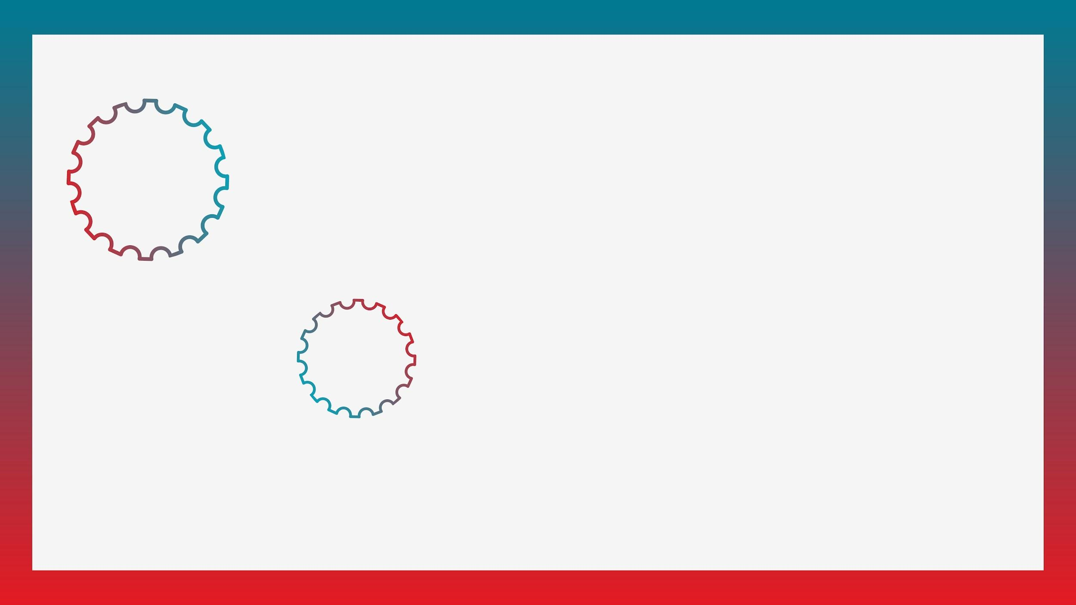

Take Another Workshop
With [Name]!
Customize It!
Sign up at ga.co/[YourName]
Notes:
Customize it!
Replace all bracketed “[ ]” text (in the yellow highlighted text and in the URL in the red box (i.e., ga.co/YourName)) with your name.
Reach out to your GA point of contact to have a ga.co short link created for you.
Right click on the circle labeled “Your photo” and select “Replace image” > “Upload from computer.” Select your desired photo from your computer and click “Open.”

Slide 113

Workshops @ GA
Check out our coding workshops in:
HTML & CSS
JavaScript
Python
Programming for Non-Programmers
Or explore all of our upcoming workshops: ga.co/workshops
‹#› | © 2020 General Assembly

Slide 114
Take Your Next Step with GA
 | Front-End Web Development | Python Programming | Software Engineering Immersive
Format | Part-time/evenings | Part-time/evenings | Full-time/Monday–Friday
Next Course | <DATES> | <DATES> | <DATES>
Outcome | Learn to develop beautiful web pages with HTML, CSS, & JavaScript. | Dive into fundamental concepts and techniques, and build your own custom web application with Python. | Learn the skills to become an entry-level web developer and the resources to get a job in this intensive program.
Tuition | $3,950* | $3,950* | $<PRICE>*
*Financing options available.
‹#› | © 2020 General Assembly

Slide 115

Fund Your Future
We offer a range of student financing and payment options to make your path to education easy, including:
Installment plans
Loans
Scholarships
Income Share Agreements
…and more!
To explore all of our financing options, visit ga.co/financing.
‹#› | © 2020 General Assembly

Slide 116



Let’s Keep In Touch!
Curious about our courses? Speak to our admissions team and they’ll help you find the right path!
Admissions: ga.co/FindYourCourse
Want to experience GA beyond the classroom?
Events: ga.co/events
Follow us!
@generalassembly
@GA
@generalassembly
‹#› | © 2020 General Assembly

